Slide 1
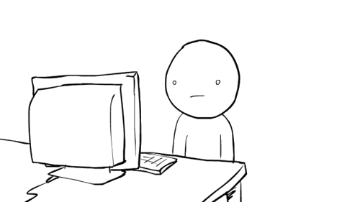

Slide 3
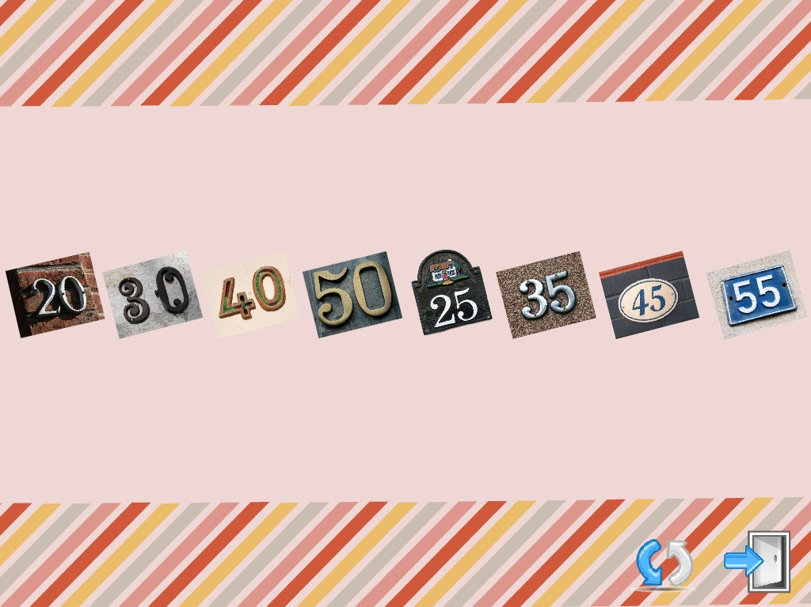

Slide 4
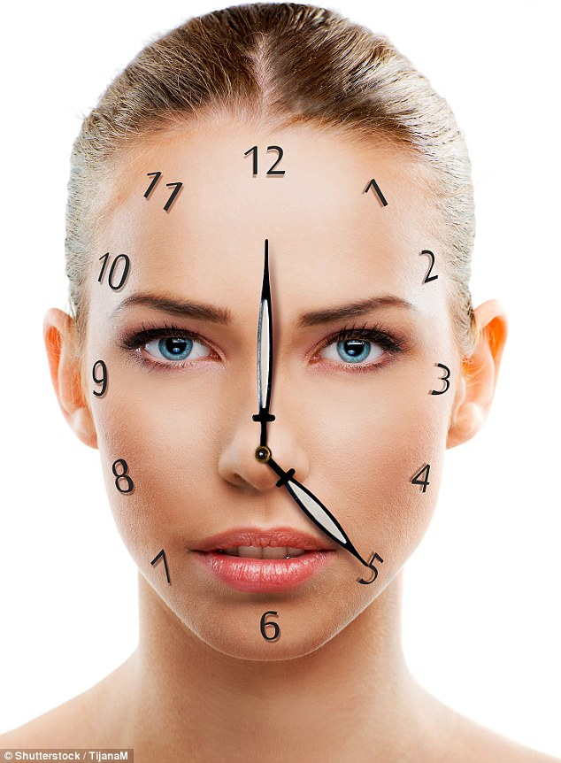
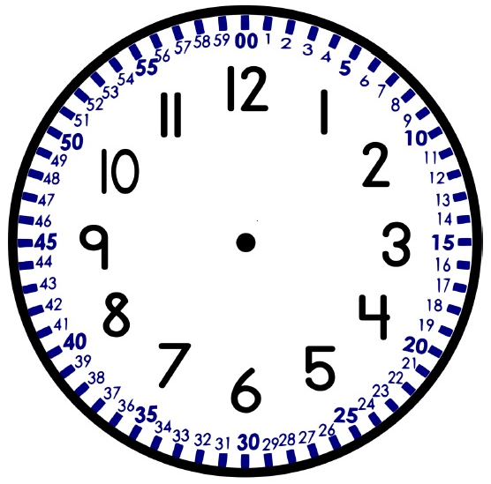
body clock

Slide 5
【第四週英語作業】
聽: CD1(第23~29首)，每聽3遍請家長簽一次名。
背:課本p8-p9的數字，下週英語課進行時間小考。
寫:完成英語習寫簿黏貼的學習單。

Slide 6
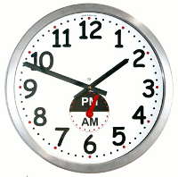
AM= am =A.M.=a.m.
PM= pm =P.M.=p.m.
AM 的原文是Ante Meridiem，意指中午（noon）之前。
PM 的原文是Post Meridiem，意指中午（noon）之後。
morning
afternoon
evening
night

Slide 7
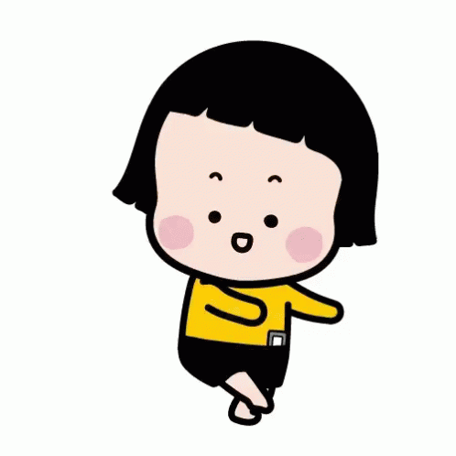
早上5點就是five am
下午３點是 three pm
中午12點=12:00 pm = noon
半夜12點=00:00 am = midnight

Slide 8
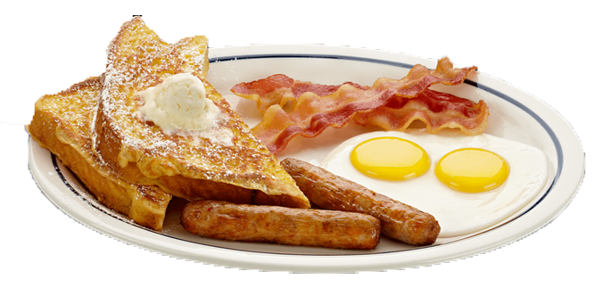
It’s seven o’clock.
(AM)
Time for breakfast.

Slide 9
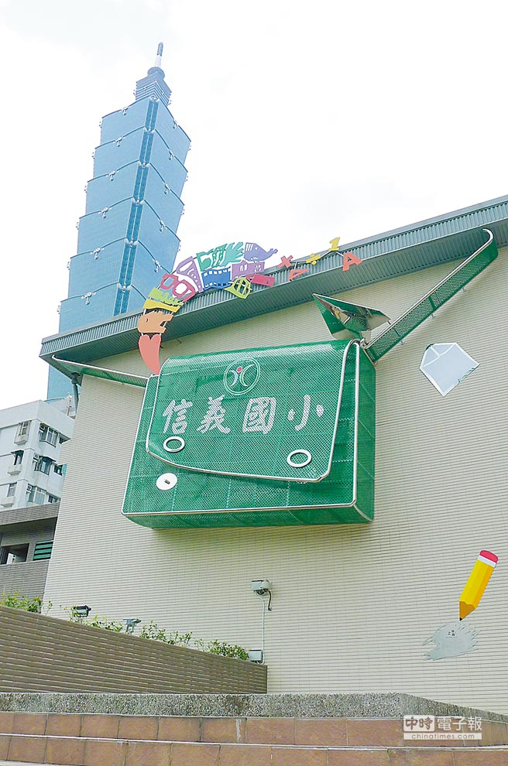
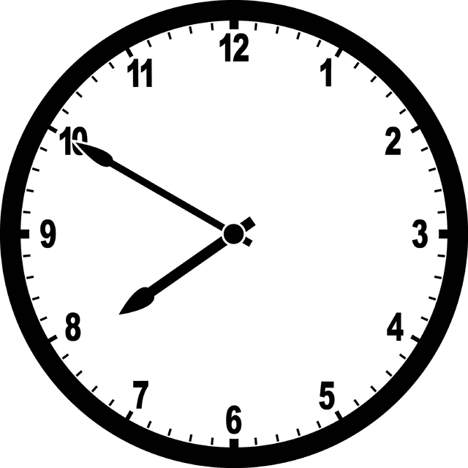
It’s seven fifty.
(AM)
Time for school.

Slide 10
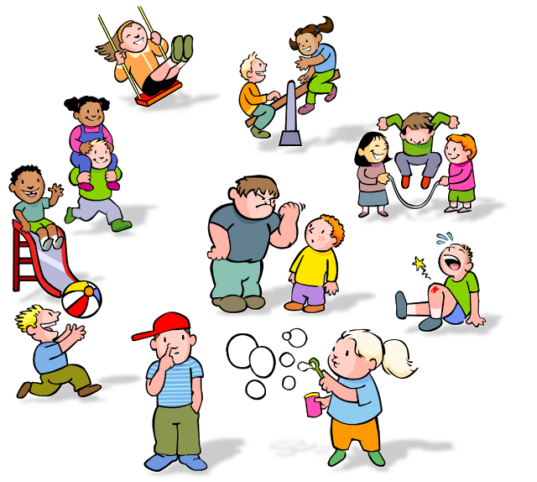
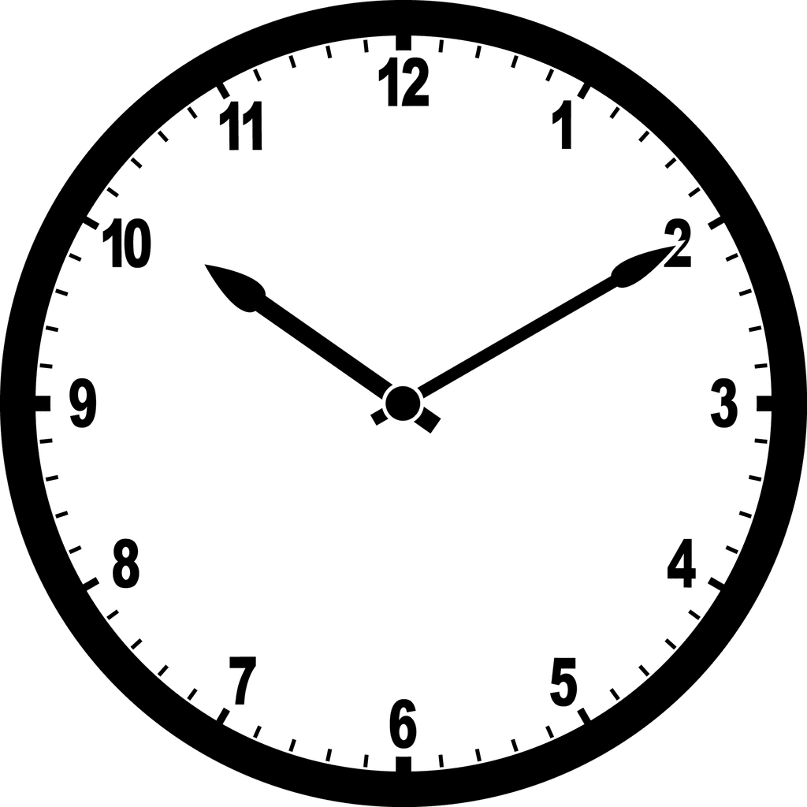
It’s ten ten .
(AM)
Time for recess.

Slide 11
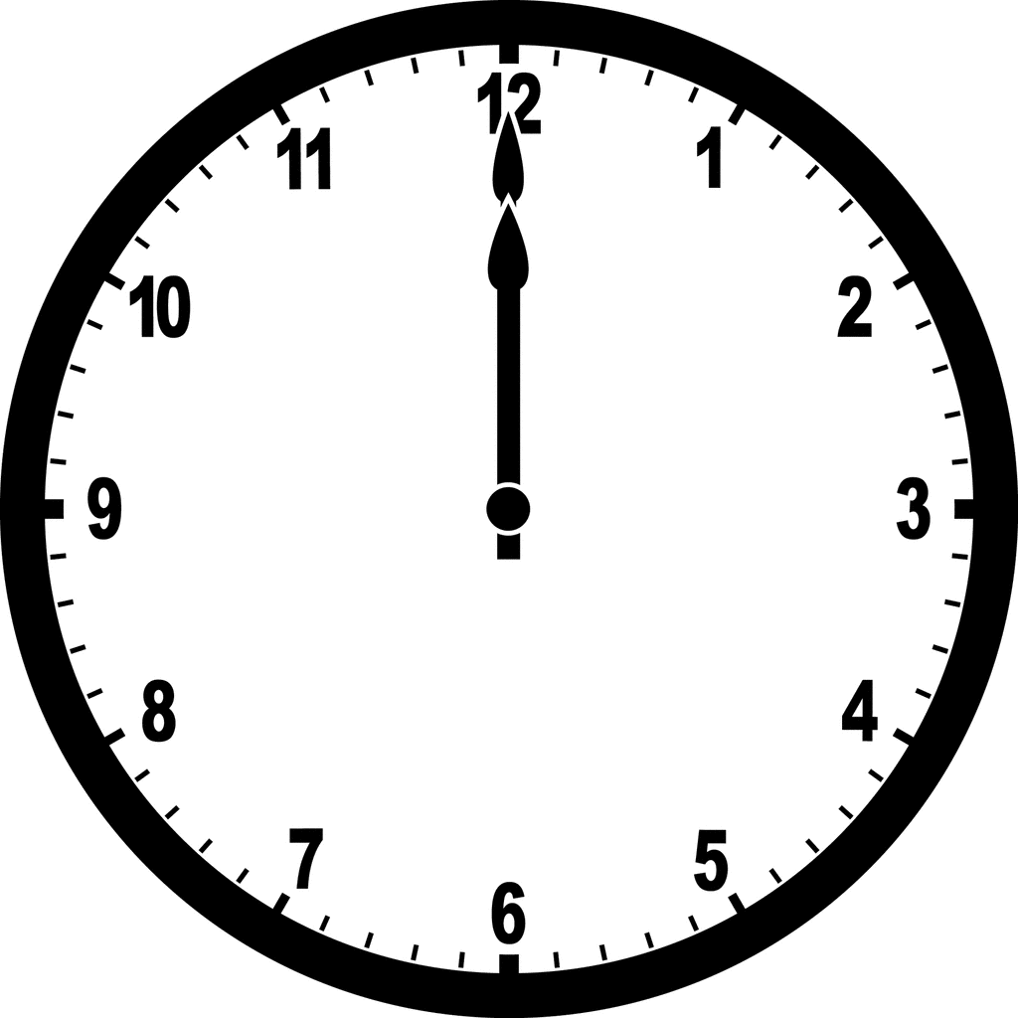
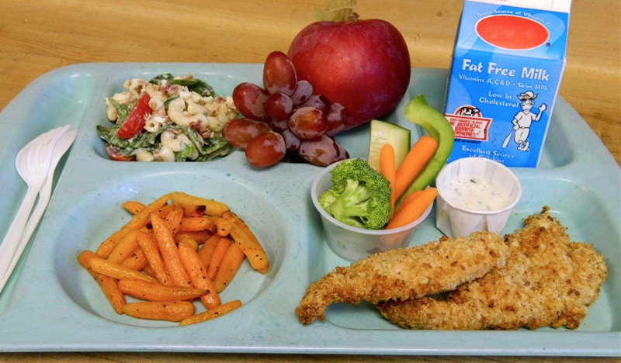
It’s twelve o’clock.
(PM)
Time for lunch.

Slide 12
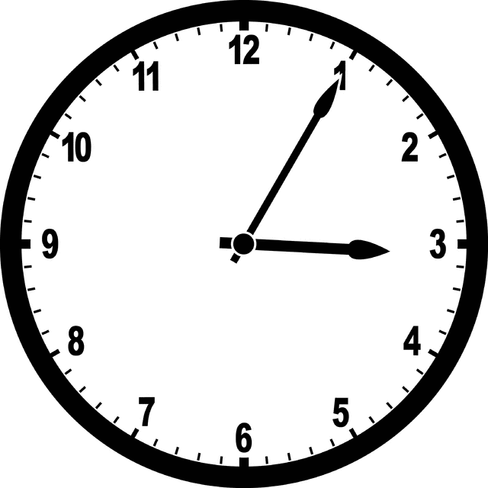
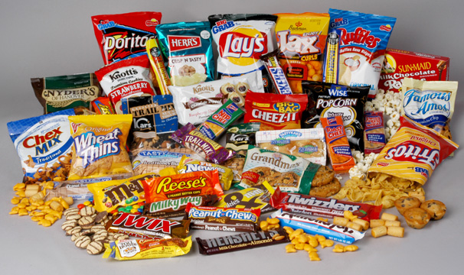
It’s three oh five.
(PM)
Time for snack.

Slide 13
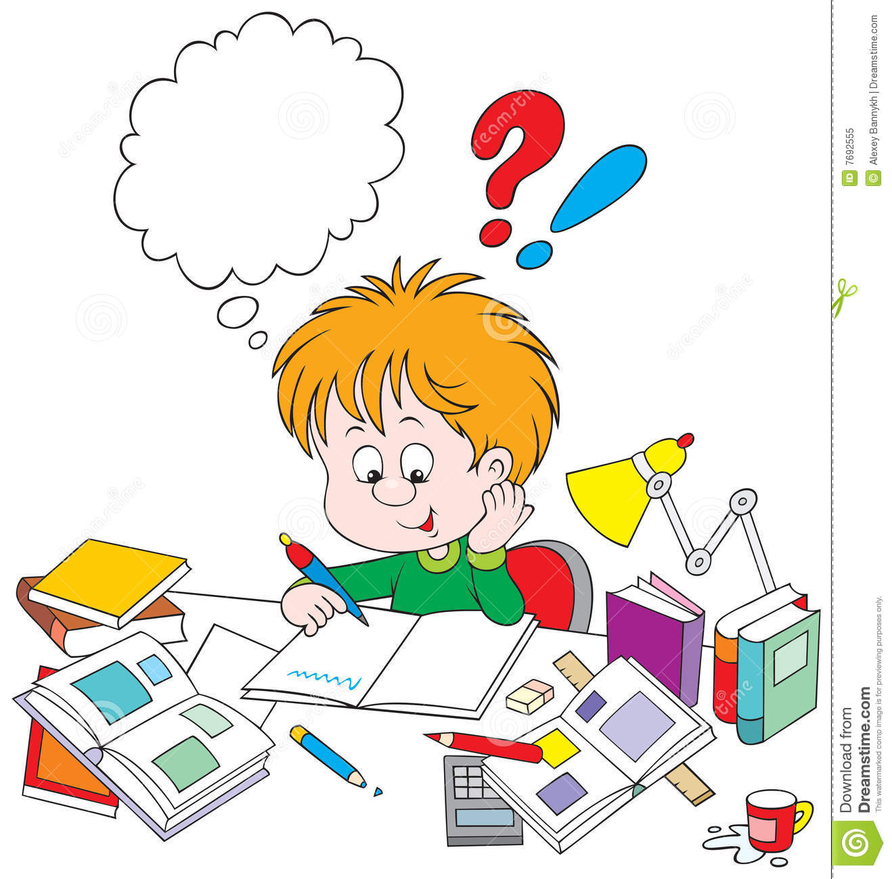
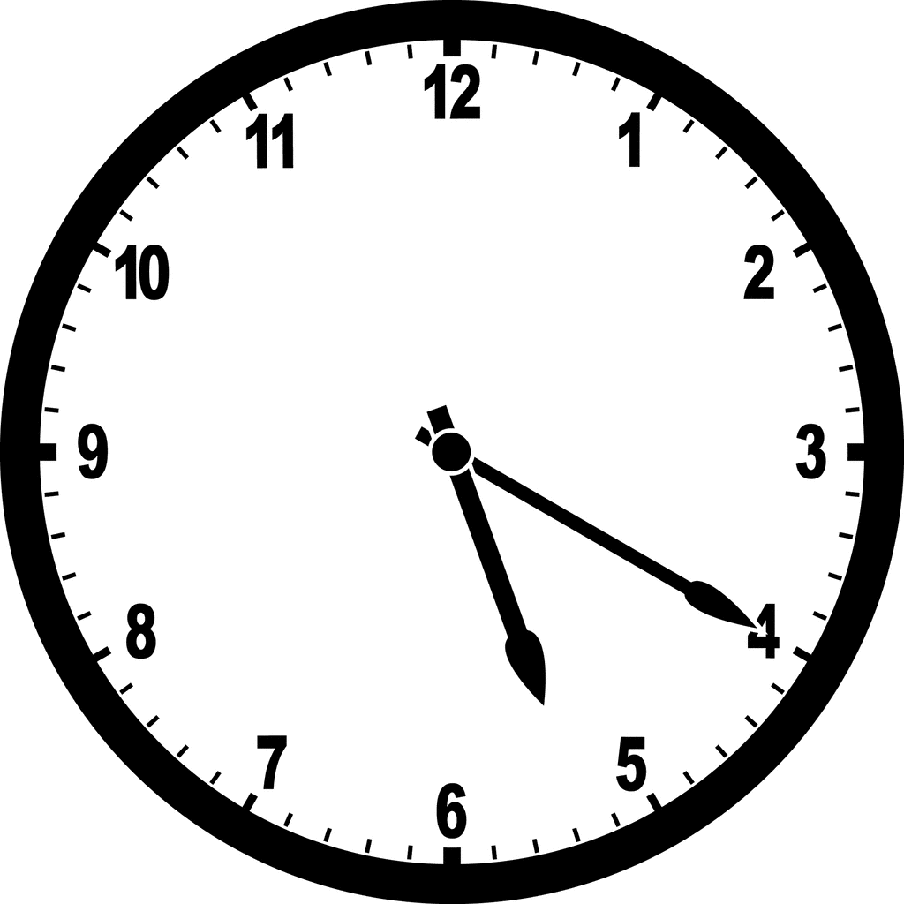
It’s five twenty.
(PM)
Time for homework.

Slide 14
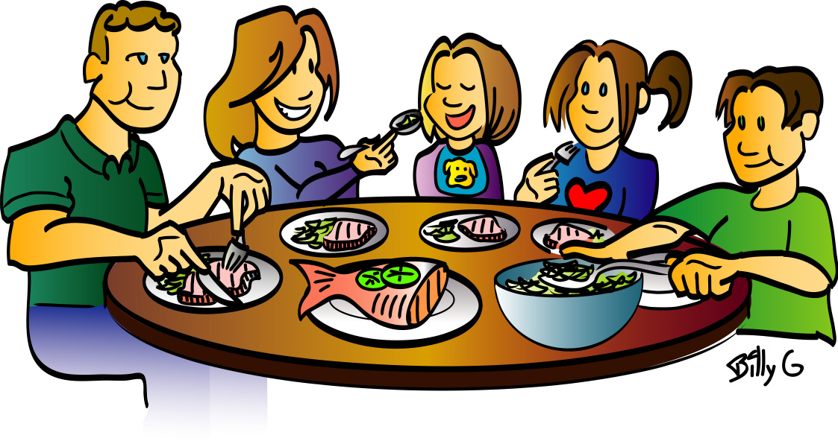
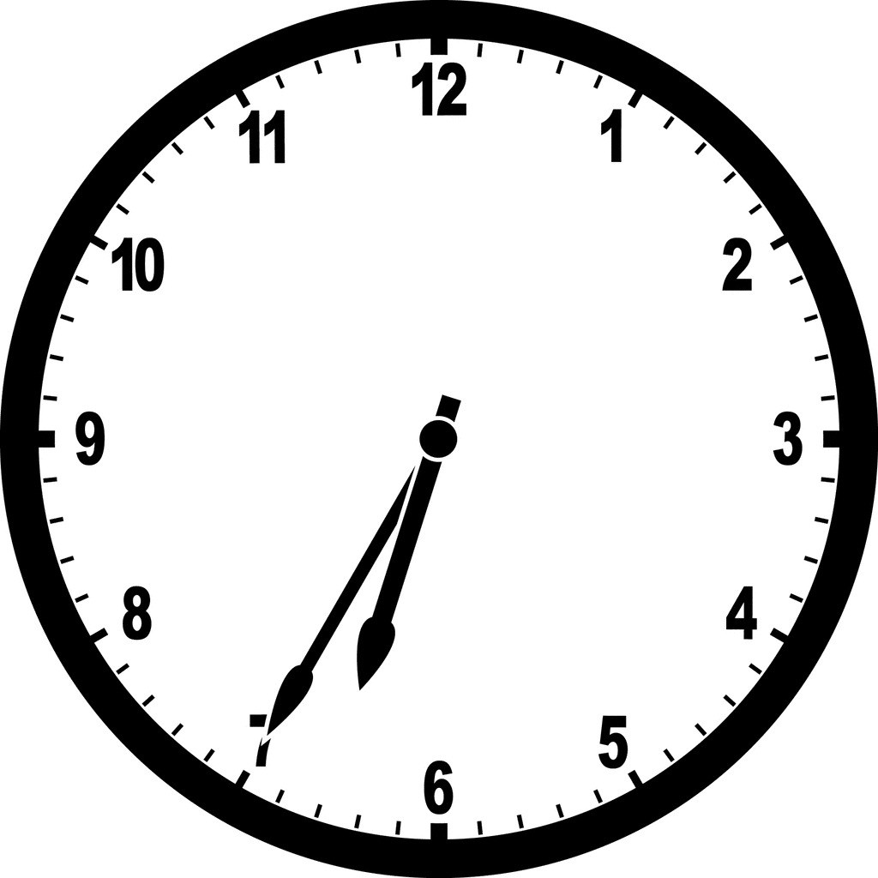
It’s six thirty-five.
(PM)
Time for dinner.

Slide 15
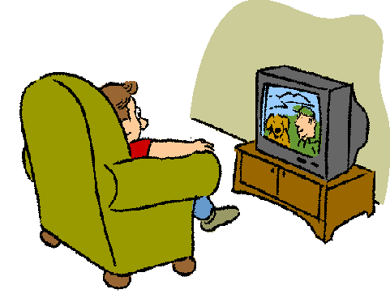
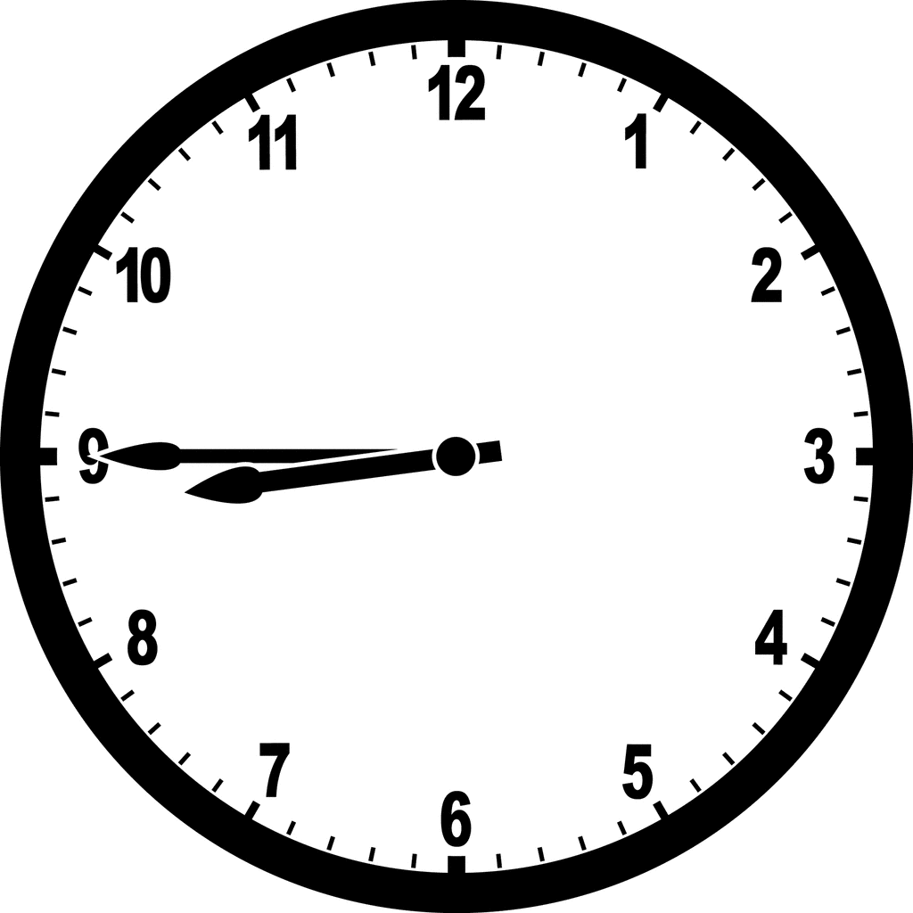
It’s eight forty-five.
(PM)
Time for TV.

Slide 16
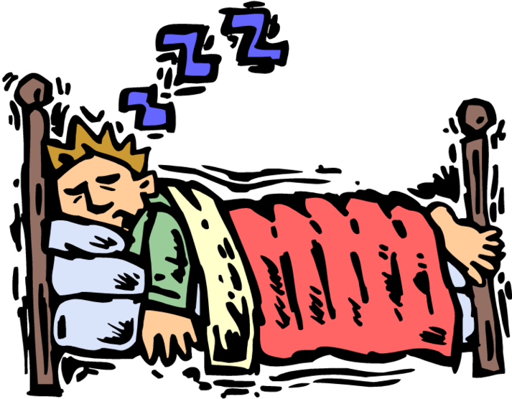
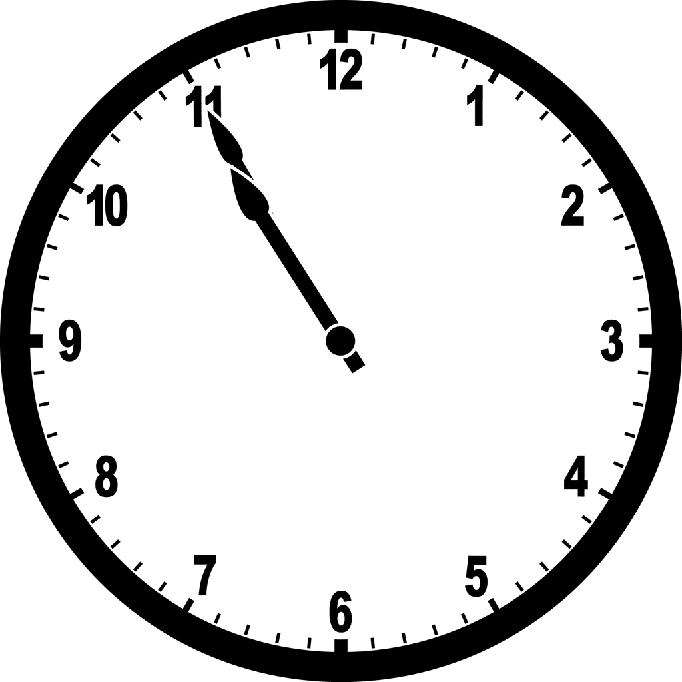
It’s ten fifty-five.
(PM)
Time for bed.

Slide 17
It’s seven o’clock.
(AM)
Time for breakfast.

Slide 18
It’s seven fifty.
(AM)
Time for school.

Slide 19
It’s ten ten .
(AM)
Time for recess.

Slide 20
It’s twelve o’clock.
(PM)
Time for lunch.

Slide 21
It’s three oh five.
(PM)
Time for snack.

Slide 22
It’s five twenty.
(PM)
Time for homework.

Slide 23
It’s six thirty-five.
(PM)
Time for dinner.

Slide 24
It’s eight forty-five.
(PM)
Time for TV.

Slide 25
It’s ten fifty-five.
(PM)
Time for bed.

Slide 26
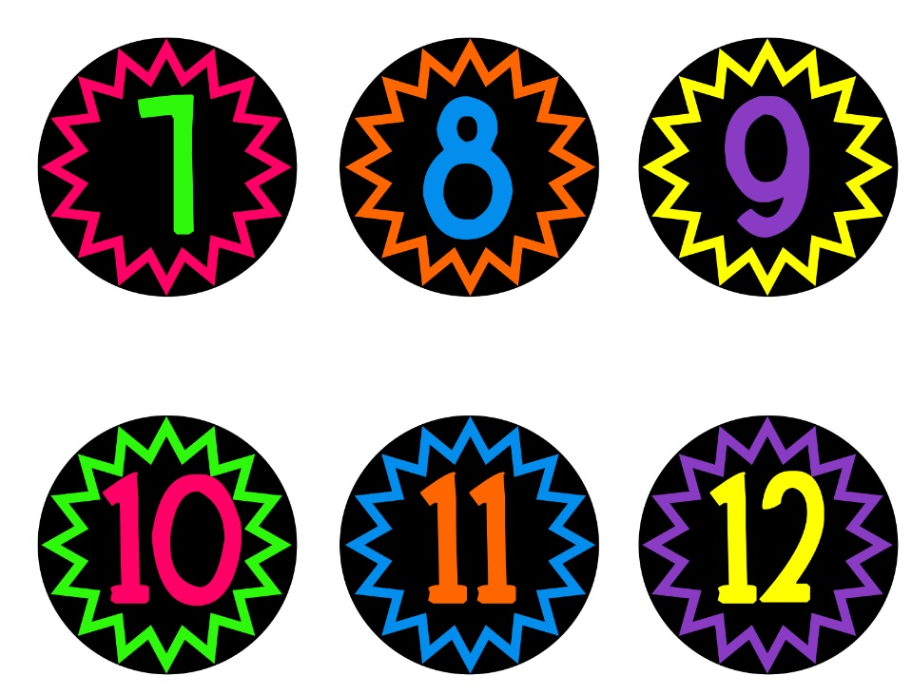
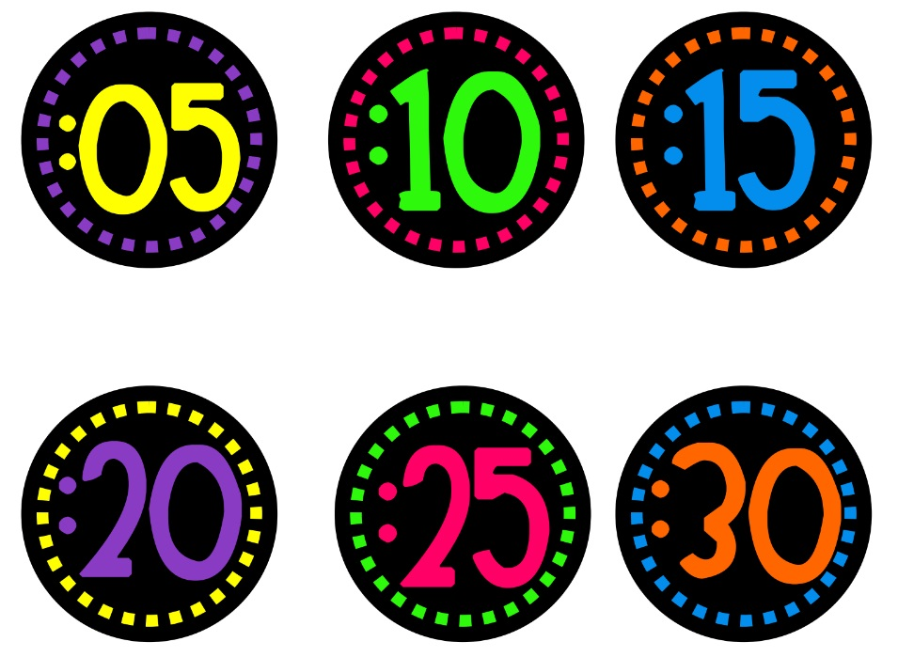
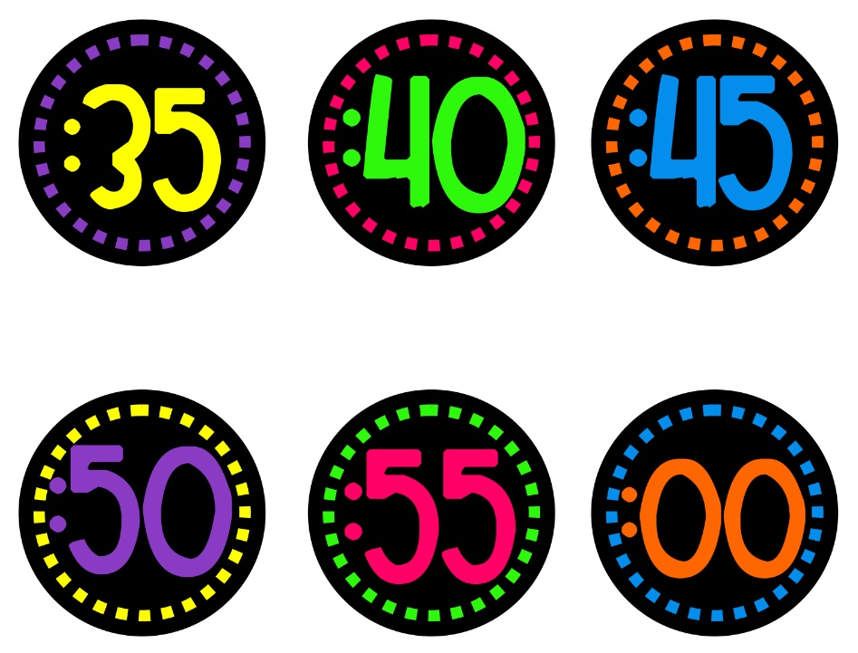

Slide 27
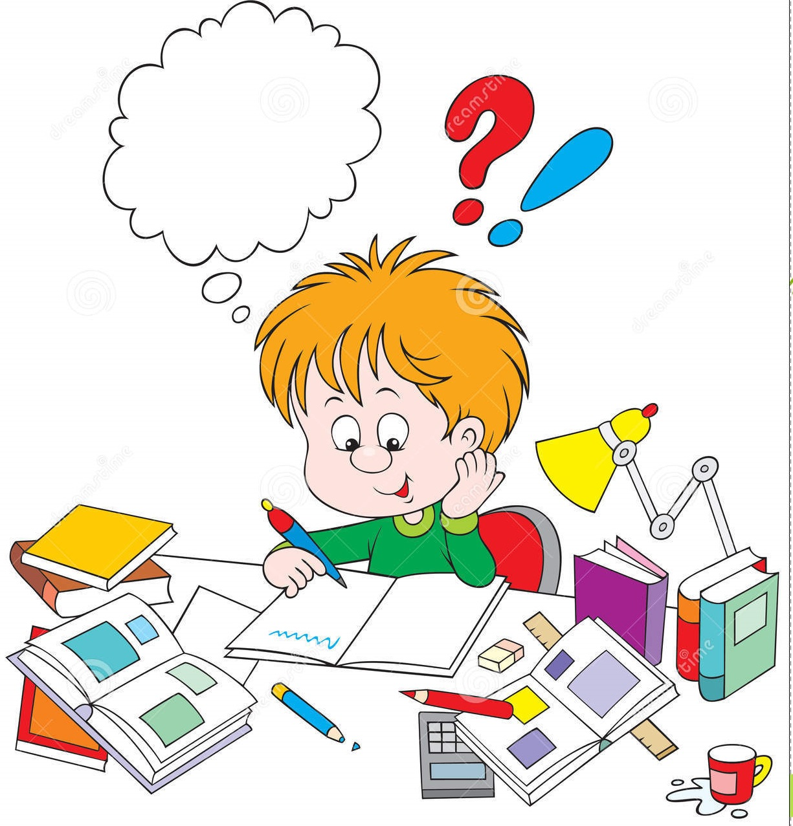
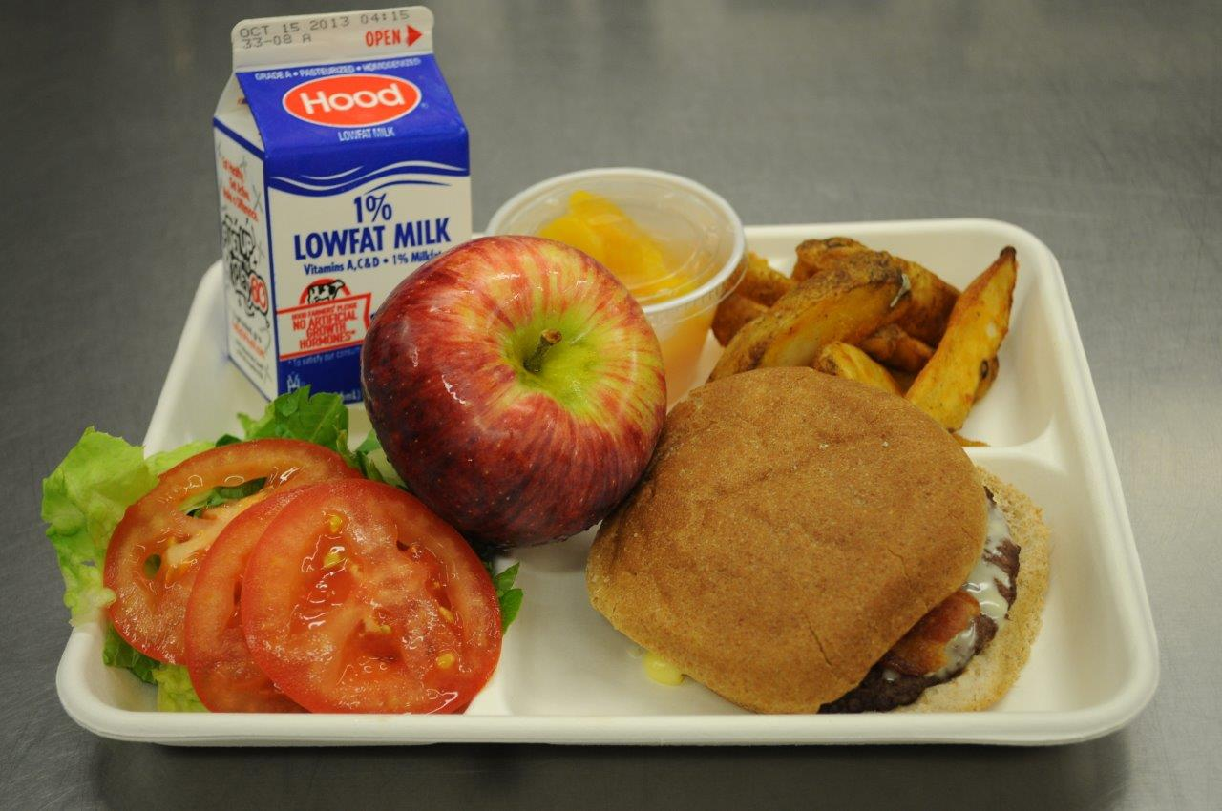
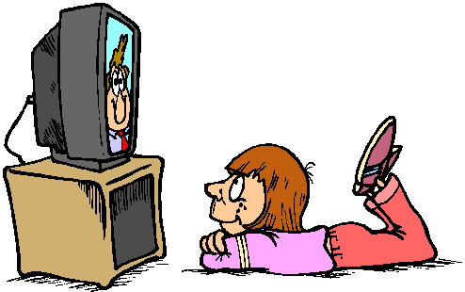

Slide 28
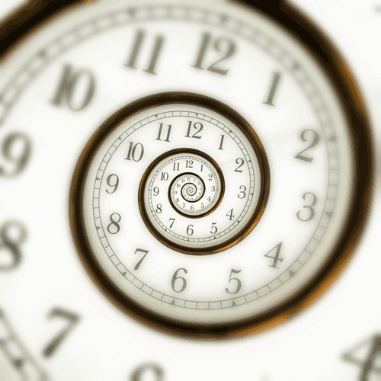
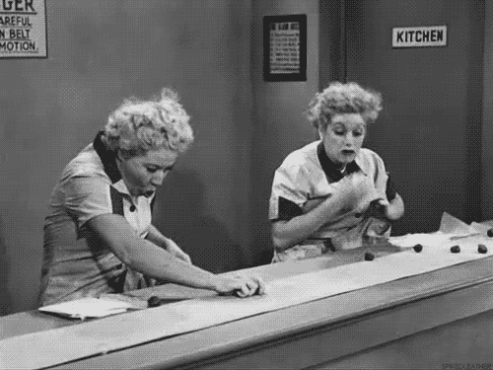
seven hands and eight feet

